Slide 1





Special-Purpose Functionalities: Intermediate Solutions
Hexa-X: WP7
Hexa-X
hexa-x.eu

Slide 2

Hexa-X:
A flagship EU B5G/6G project
A flagship for 6G vision and intelligent fabric of technology enablers connecting human, physical, and digital worlds
Looking forward into 2030 and beyond, the ambition of the Hexa-X project includes developing key technology enablers in the areas of:
  fundamentally new radio access technologies at high frequencies and high-resolution localization and sensing;
  connected intelligence through AI-driven air interface and governance for future networks, and
  6G architectural enablers for network disaggregation and dynamic dependability.

Slide 3
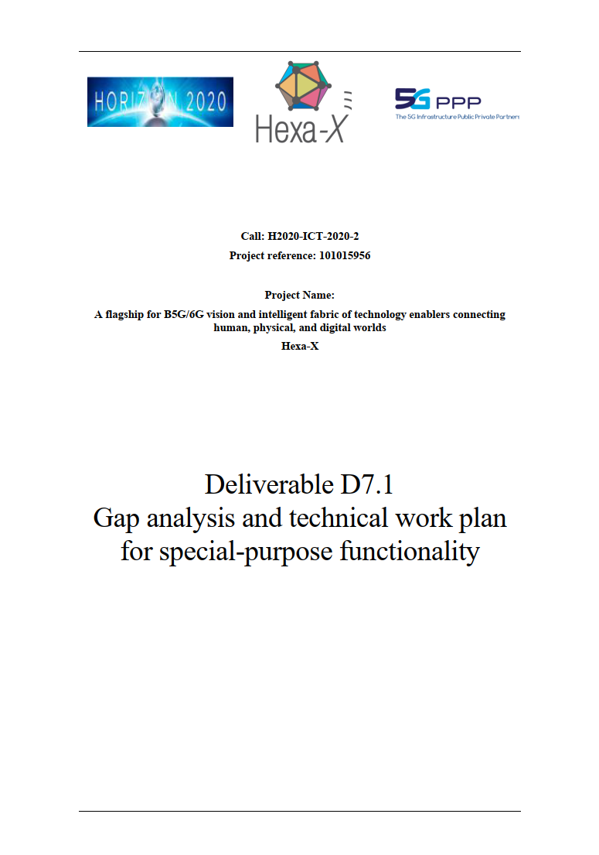
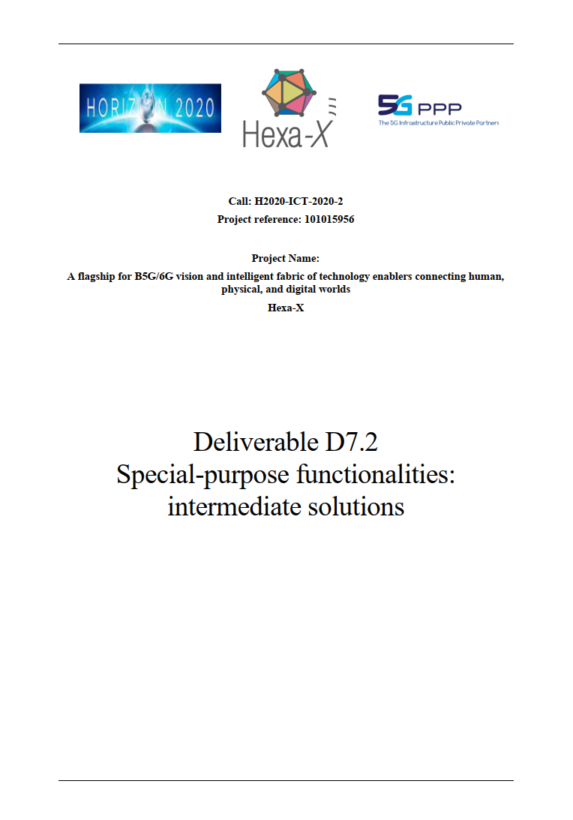
Working Package 7:
Mission and scope
WP7 studies enablers for
increased dependability and sustainable coverage,
including Digital Twins and novel HMIs to enable extreme experiences
It contributes to the expansion and evolution of the network into new use cases and value chains
D7.1 contains results of the gap analysis and the technical work plan for WP7
D7.2 contains an overview of intermediate solutions and their relation to other Hexa-X technical enablers and KPIs/KVIs

Slide 4
Core use cases
Addressing sustainable coverage and dependability

Slide 5



Hexa-X use cases including additional telepresence use cases considered in WP7
Consumer robots
AI partners
Interacting and cooperative mobile robots
Flexible manufacturing
Fully merged cyber-physical worlds
Mixed reality co-design
Immersive sport event
Merged reality game/ work
Telepresence videoconferencing
Telepresence robotics
Robots to cobots
Telepresence
Local trust zones
Precision healthcare
Sensor infrastructure web
6G IoT micro-networks for smart cities
Infrastructure-less network extensions and embedded networks
Local coverage for temporary usage
Small coverage, low power micro-network in networks for production & manufacturing
Automatic public security
Massive twinning
Sustainable development
Digital Twins for manufacturing
Immersive smart cities
Digital Twins for sustainable food production
Additional evolving use cases
E-health for all
Institutional coverage
Earth monitor
Autonomous supply chains

Slide 6
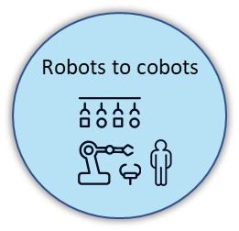
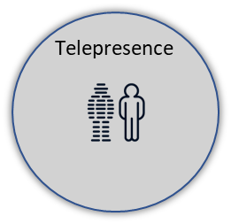
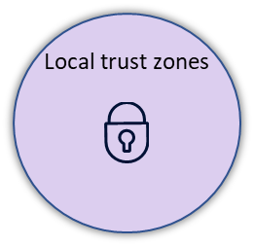
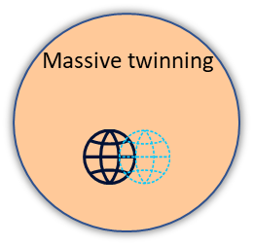

WP7 selected use cases targeting dependability and sustainable coverage
Consumer robots
AI partners
Interacting and cooperative mobile robots
Flexible manufacturing *
Fully merged cyber-physical worlds
Mixed reality co-design
Immersive sport event
Merged reality game/ work
Telepresence videoconferencing
Telepresence robotics
(*) aspects included
Precision healthcare
Sensor infrastructure web
6G IoT micro-networks for smart cities
Infrastructure-less network extensions and embedded networks
Local coverage for temporary usage
Small coverage, low power micro-network in networks for production & manufacturing
Automatic public security
Dependability
in I4.0
Digital Twins for manufacturing
Immersive smart cities
Digital Twins for sustainable food production
Sustainable coverage
in IoT
E-health for all
Institutional coverage
Earth monitor
Autonomous supply chains

Slide 7


Focus on dependability and sustainable coverage
Dependability is the "ability to perform as and when required".
The underlying KPIs serve as an indicator for the Hexa-X key value trustworthiness.
Sustainable coverage is the Hexa-X ambition to target spatial coverage and inclusion under explicit consideration of sustainability aspects and capabilities.
Resilience
AIaaS,
CaaS
WP4
Dependability
Extend end-to-end for applications
Increase for individual services
Communication
Productivity
Positioning,
Sensing
WP3
Cost of generated insight
Value of generated insight
increase in:
- required computational power
- energy consumption
- hardware production/distribution
reduction in:
- overall energy consumption
- environmental pollution
- electronic waste
- EMF exposure
- unnecessary behavior (e.g., traffic)
Flexibility - Ability to adapt to changing
tasks related to sustainable coverage
- cost (monetary and resources) associated change
- grade of re-use of components

Slide 8





Three focus topics for special-purpose functionality
Ultra-flexible resource allocation
Dependability in I4.0
HMIs and digital twins
Ultra-flexible resource allocation procedures in challenging environments such as those populated by mobile devices with special requirements and in need of coverage.
Mechanisms and enablers for high dependability in vertical scenarios, enabling efficient resource support of complex and dynamically changing availability requirements.
Convergence of the biological, digital and physical worlds with human interaction through novel HMI concepts and a privacy-preserving high-availability Digital Twin.
Notes:
find 3 icons (one for each topic, reuse on later slides)

Slide 9
Details on use cases and requirements
Collaborating robots, DTs for manufacturing, telepresence, earth monitor, autonomous supply chains, immersive smart cities, and IoT micro-networks for smart cities

Slide 10
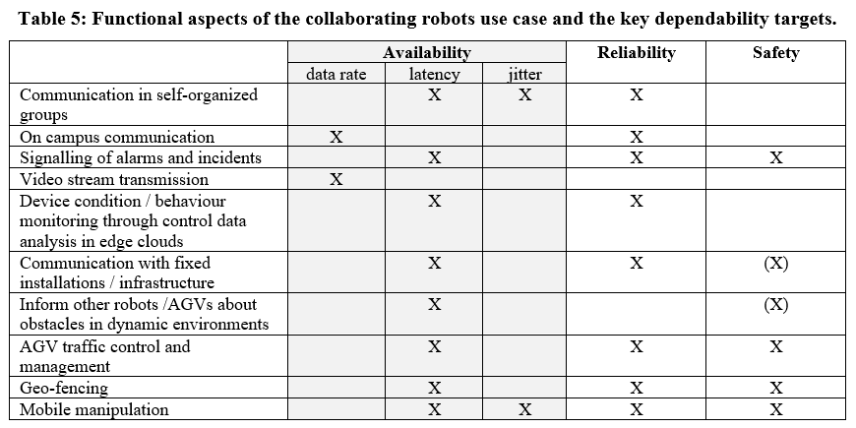
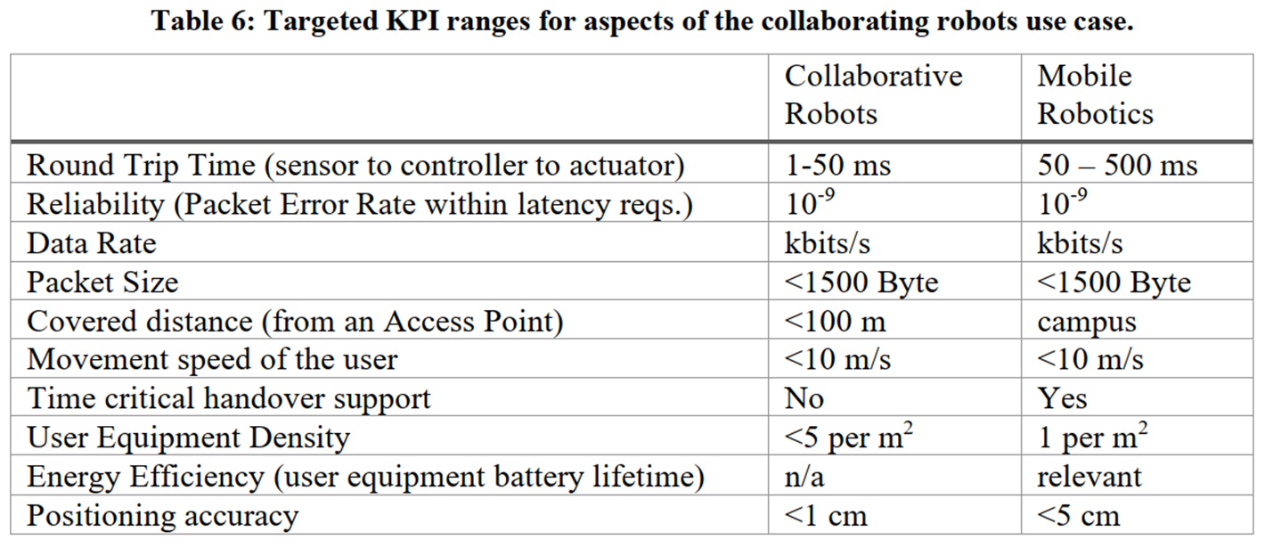
Collaborating robots
Functional aspects of the use case mapped to
dependability attributes of different services
Discussion of application productivity as
consequence of utilized services and resilience
  Communication, computation, positioning
Targeted ranges for functional aspects of the
collaborative robots use case

Slide 11
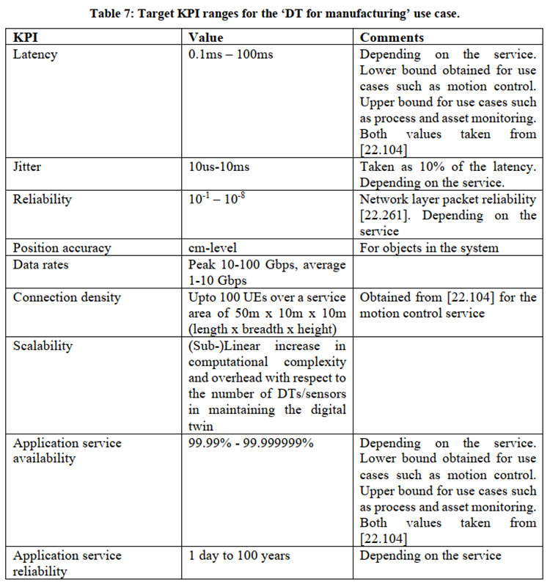
Digital twins for manufacturing
DT KPIs heavily depend on the respective service
Trustworthiness
  Privacy: cannot violate human privacy for example location of individuals without consent, storing identifiable data is not allowed, careful with ML/AI
  Ethical frameworks: when human workers are involved, worker rights need to be followed also from ethical standpoint, including diversity
Flexibility
  Scalability
  Transferability: common framework and creation principles
  Composition: possibility to create compound digital twins of larger entities

Slide 12
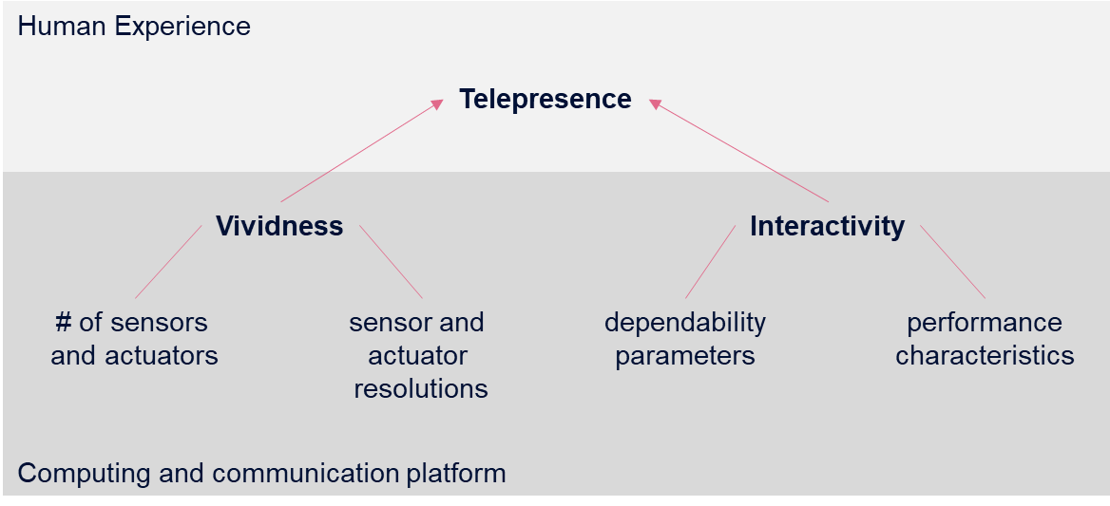
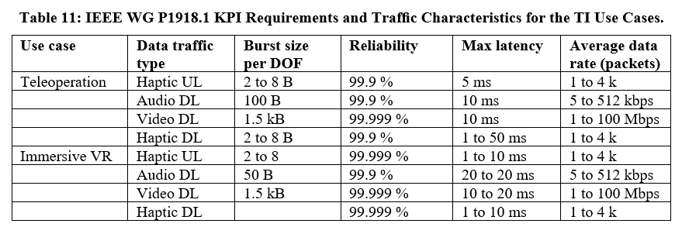
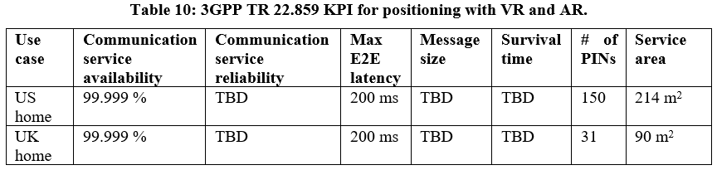
Telepresence
Requirements for telepresence robotics (Tactile Internet) and telepresence videoconferencing (holographic telepresence)
Vividness: richness of environment (dep. on representation to human senses)
Interactivity: extent to which humans contribute to changing an environment in real-time
  Dependability (compute, communicate)
  Performance (compute, communicate)

Slide 13
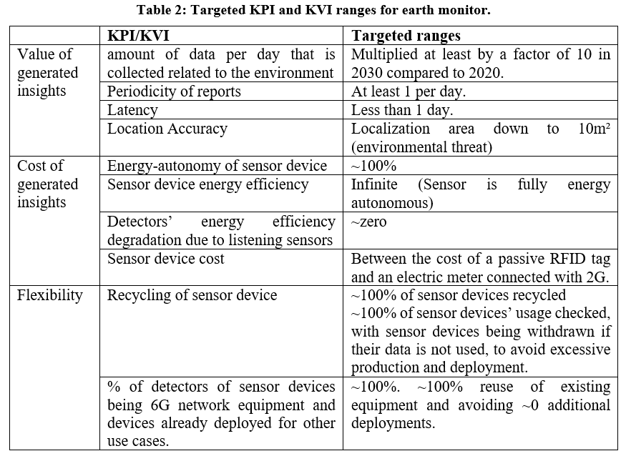
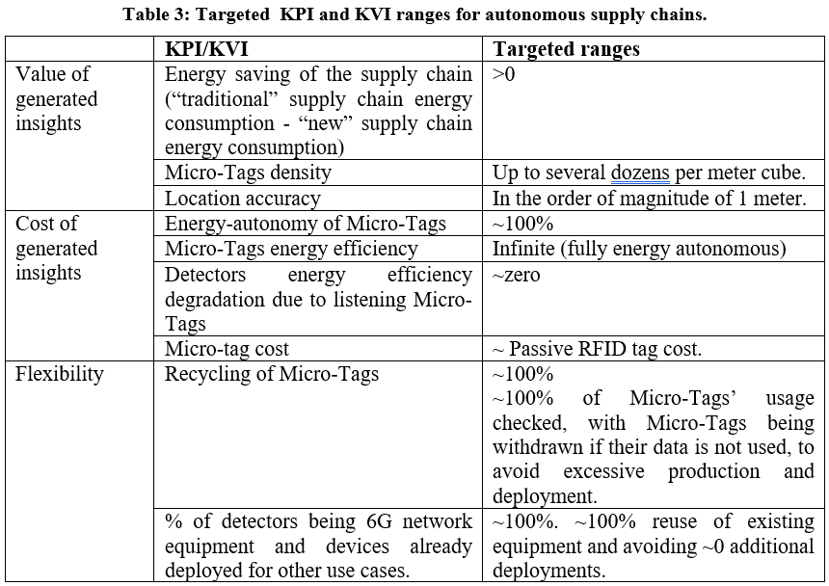
Earth monitor
Autonom. supply chains
Value and cost of generated insights
  associated attributes (KPIs)
  Focus on energy autonomy of tags
  combined with exist. infrastructure
Flexibility (both use cases)
  Recycling
  % of dedicated infrastructure for task
  (also related to cost of gen. insights)

Slide 14
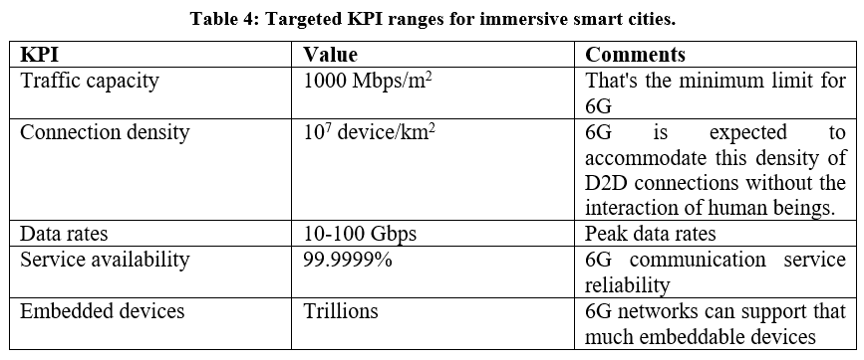
Immersive smart cities
Focus on high-level requirements for service
due to very broad scope of scenarios
Derived DT requirements → DT use case
Focus on functional requirements to tackle
immersive smart cities requirements
  Architecture: relaying, high frequency bands
6G IoT micro-networks
for smart cities

Slide 15
Intermediate solutions
Overview of technical contributions by T7.2, T7.3, T7.4

Slide 16
Overview
T7.2: Ultra-flexible resource allocation in challenging environments
Joint resource allocation across frequencies
Federated AI/ML-based allocation utilizing communication patterns
Intent-based utilization of D2D and D2I links
Interference management (prediction and modeling)
Flexible (re-) distribution of application functionality on execution platforms (T7.4)
Trade-off between energy consumption and performance in I4.0 scenarios
T7.3: (E2E) dependability in I4.0 environments
Extend the communication-control-co-design paradigm
Mathematical framework for dependability analysis in multi-connectivity setup
System architecture design including resource allocation aspects (T7.2) and deployment options (T7.4)
Monitoring and anomaly detection in I4.0 scenarios
Trade-off between network resource utilization and control utility
T7.4: Digital Twins and novel HMIs
Application execution environment guaranteeing high levels of privacy, user transparency, and availability
DTs enabling critical (industrial) applications, e.g., enhanced human-machine/human-CPE interaction
Concept of accompanying, collaborating DTs for privacy preserving data analysis and insight generation

Slide 17

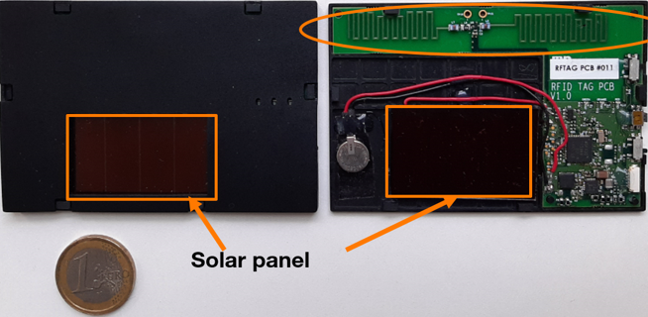
Enablers for ultra-flexible resource allocation
Network enablers in focus
Applications in focus
In-Machine communication (NW-in-NW) in factories
Radio-aware trajectory planning in factories, flexible radio mapping
WP5
Dependability
in I4.0
Flexible functional split adaptation in factories
Resource allocation and function (re-)distribution in factories
WP5
Crowd-detectable zero-energy devices for smart tracking
Sustainable
coverage in IoT
Resource provisioning for Federated Learning in IoT
WP4
Related measurable result for project objective 4:
Flexible resource allocation in demanding industrial scenarios

Slide 18



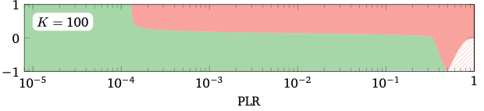



Enablers for dependability in I4.0
CoCoCo: understanding and modeling the impact of real-world constraints on applications
Communication-
computation-
control-
co-design
Focus topics
Impact of temporal correlation of packet losses on industrial control applications
Cross-domain reliability modeling, demonstrated with inverted pendulum example
Development of method for best trade-off between sum-rate, power, delay and EMF exposure in computational offloading scenarios
Control
application
unstable
stable
Communication-
computation-
co-design
Compute
resources
Network
WP4
Machinery
Related measurable result for project objective 4:
Flexible resource allocation in demanding industrial scenarios

Slide 19
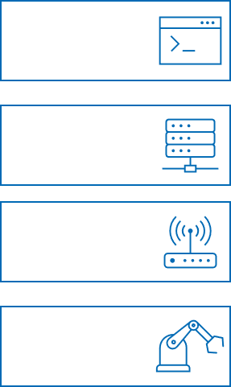

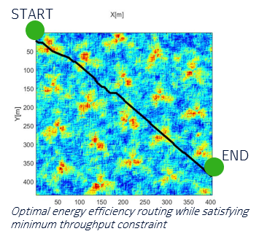
Enablers for dependability in I4.0
Quantifying and monitoring dependability, error identification
Increasing dependability with digital twins
Capture application, network, and infrastructure events
Estimate impact on application productivity (→ CoCoCo)
Utilize resource allocation strategies to mitigate failures
Incorporate BS/UE capabilities in models
Properties of transmitting nodes (trajectories, positions)
Create and maintain radio environment maps
Related measurable result for project objective 4:
Flexible resource allocation in demanding industrial scenarios

Slide 20






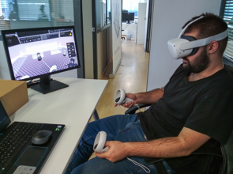
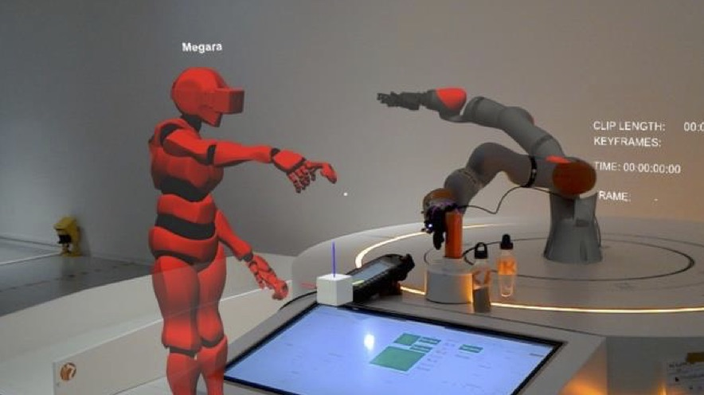

HMIs and digital twins
Ecosystem of collaborating DTs in human-centric industrial environments
Focus topics
Industrial digital twin
Collaborating DTs and 6G capabilities
WP4
I4.0 Application
Compute /
AI-as-a-Service
DT empowered collaborative robots
DTs for emergent intelligence
Network
(local mgmt.)
Network
awareness
Impact of human presence on industrial deployments
Network-aware DTs for local insights
Machinery
Localization/Sensing
Novel HMIs
Novel HMIs for mobile human-machine interaction
Bringing the human in the loop
WP3
WP1
Security
➔ resource
allocation
Related measurable result for project objective 4:
Enablers for Human-Machine-Interaction (HMI) and Digital Twins (DT)

Slide 22
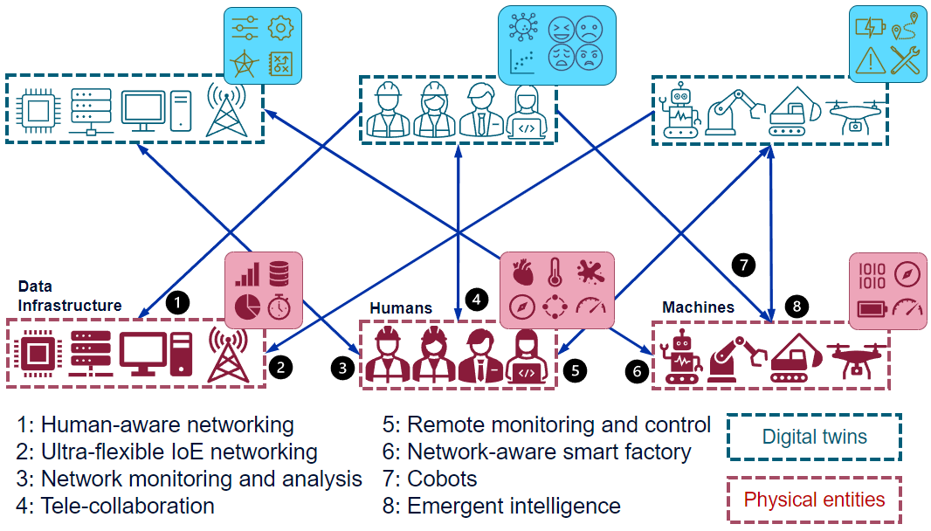
HMIs and digital twins
Ecosystem of collaborating DTs in human-centric industrial environments
Related measurable result for project objective 4:
Enablers for Human-Machine-Interaction (HMI) and Digital Twins (DT)

